Slide 1
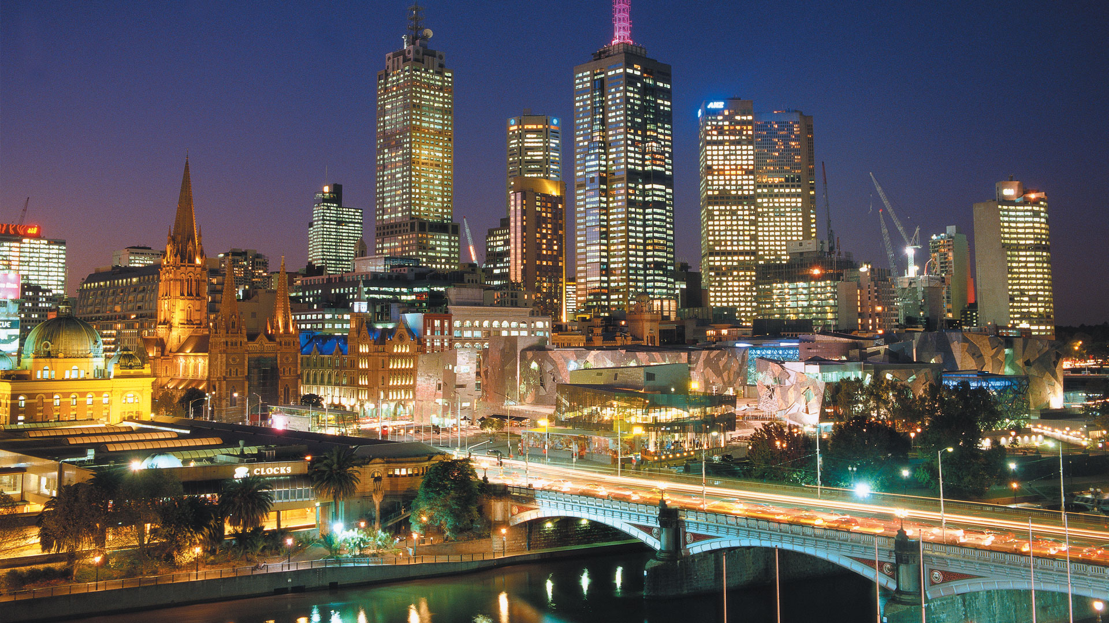
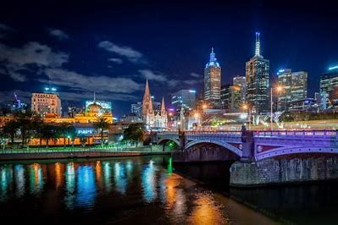
Crime in Victoria
Latest CRIME STATISTICS

Slide 2
Order of Presentation
1.Introduction & Objectives (Antoinette)
2.Criminal Incidents & Recorded Offences (Antoinette)
3.Victim Reports & Family Incidents (Jacqueline)
4.Crime status & Police Service Areas (Kelvin)
5.Victoria Crimes Trends from September 2012 to 2021 (Anh)

Slide 3

Our project team members:
Antoinette Boyle,
Jacqueline Xia,
Kelvin Hung Nguyen,
Anh Huong
"Victorian crime statistics" over the last 10 years :
large data set, numerous tables, over 300k rows
interrogated this data using excel and python in Jupyter Notebook
repository on Github with branches
4 key questions:
Top offence types and trends
Top crime by region and concentration
Whether there is a correlation between number of police stations and crimes/offence status?
Is there a concentration of police stations, by regions.

Slide 4
Introduction
CRIMINAL INCIDENTS
Over the LAST Ten Years

Slide 5
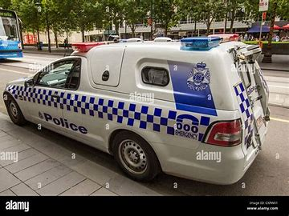
Terminology
What are?
A criminal incident.

Slide 6
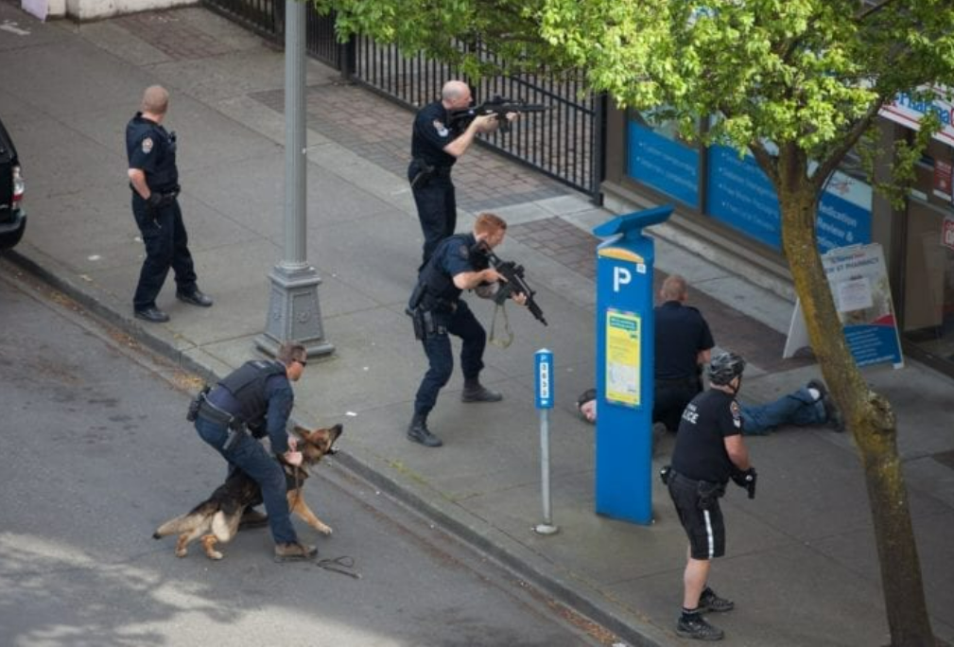
Terminology continued
What are criminal incidents?
A recorded criminal incident is a criminal event that may include one or more offences, alleged offenders and/or victims, and that is recorded on a single date and at one location.
The criminal incident count is designed to represent the broad event that occurs as a more representative measure of instances of crime, rather than using the bulk number of offences that Victoria Police members record within one incident.
Consequently, there's could be many offences in one criminal incident.

Slide 7
What type of Offences?
CRIMINAL INCIDENTS
Over the LAST Ten Years

Slide 8
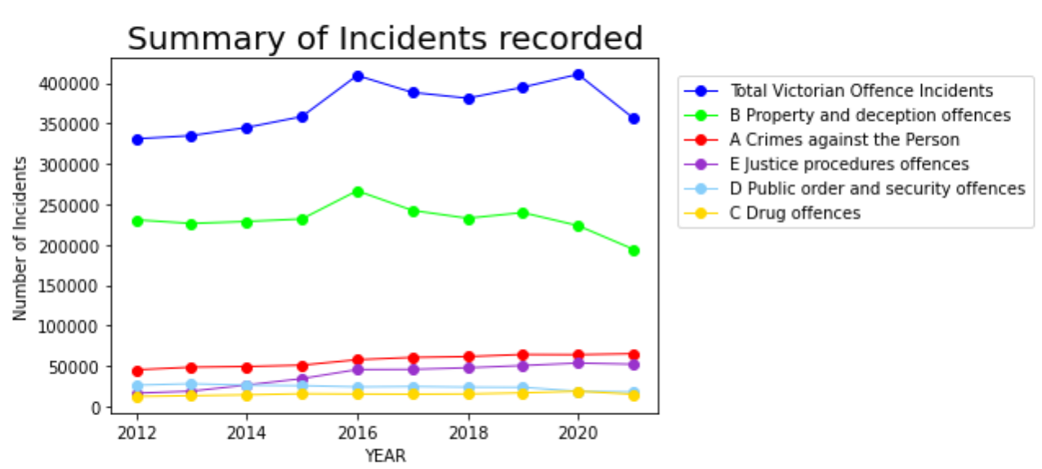
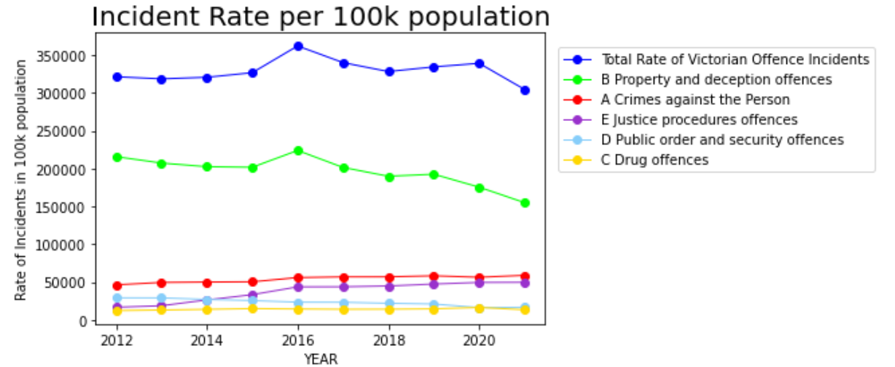
Note:
Property and deception offences (Green line) have far exceeded other Victorian offences followed by A Crimes against the person.
The peak in 2016 relates to “Theft” as we will explore in the next slide.
A significant drop in overall Crime from 2020 is mostly due to COVID lockdowns in Victoria. The rate per 100k population shows similar trends.

Slide 9
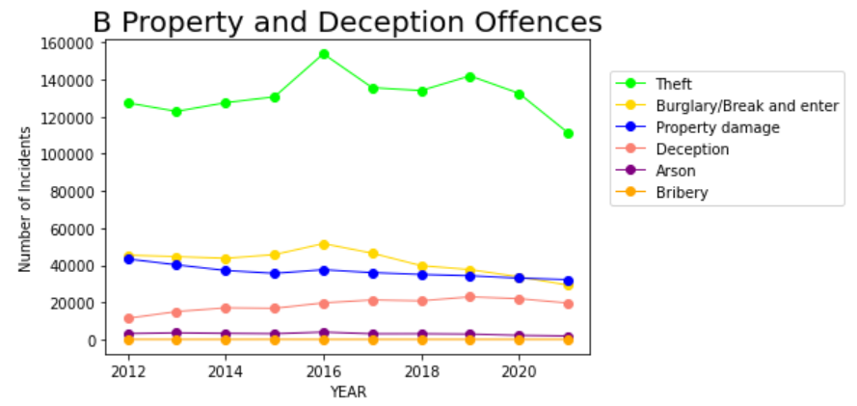
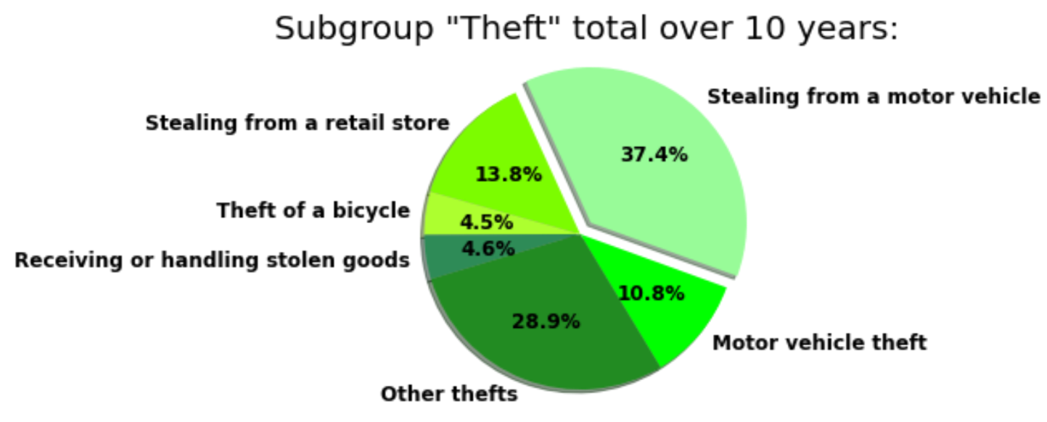
Note:
The peak in 2016 is mostly caused by “Theft”. The Moomba festival crime spree (Mar 2015) and the Bourke Road attack (Jan 2016) were both around this time.
The Covid lockdowns in 2020-2021 resulted in significantly less thefts but other crimes remained relatively stable.

Slide 10
And other more serious Offences?
CRIMINAL INCIDENTS
Over the LAST Ten Years

Slide 11
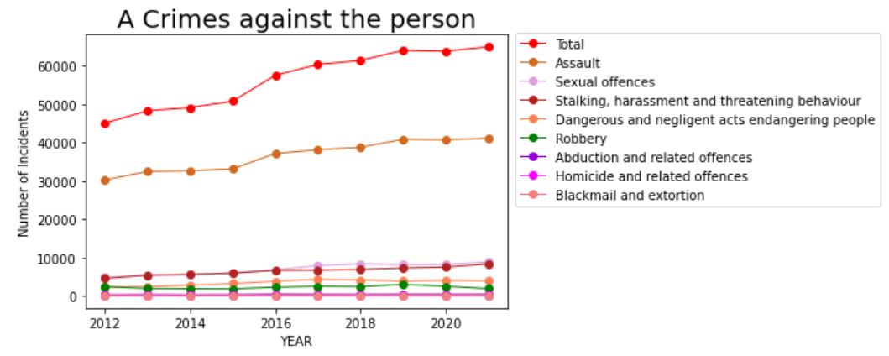
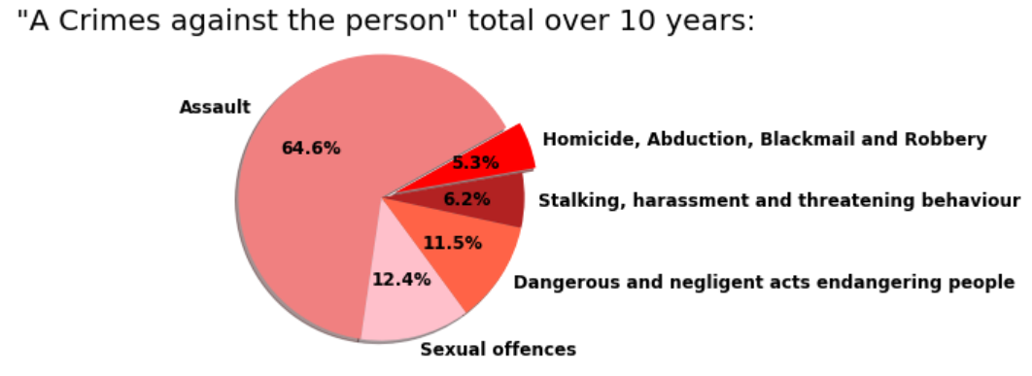
Note:
Assault is the most common crime in in this category 64%!
Assault has increased each year despite Covid 19 lockdowns.

Slide 12
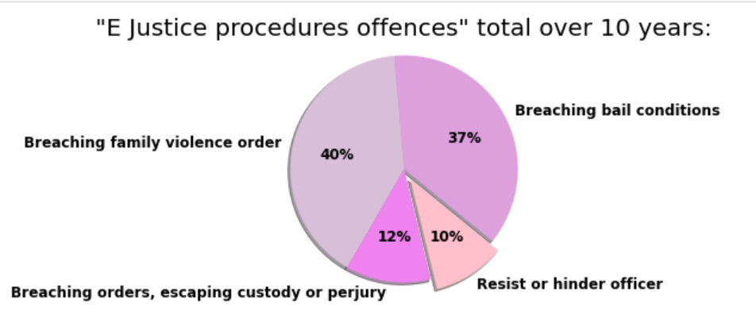
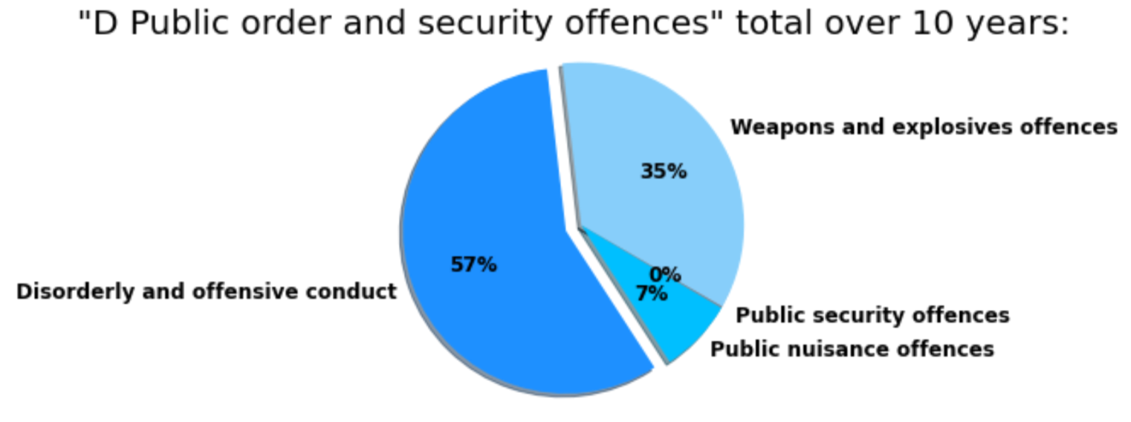
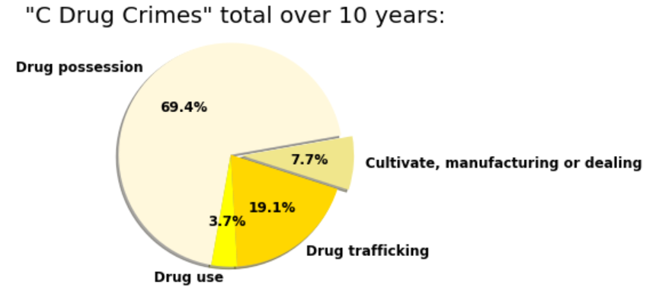
Note:
Other crimes are dominated by breaching Family violence orders(40%). Jacqueline will explore this issue in more depth.
Disorderly and offensive conduct(57%) and Drug possession(69%) are relatively high.
Weapons and explosive offences are noteworthy at 35%.

Slide 13
Where do these Offences occur?
CRIMINAL INCIDENTS
Over the LAST Ten Years

Slide 14
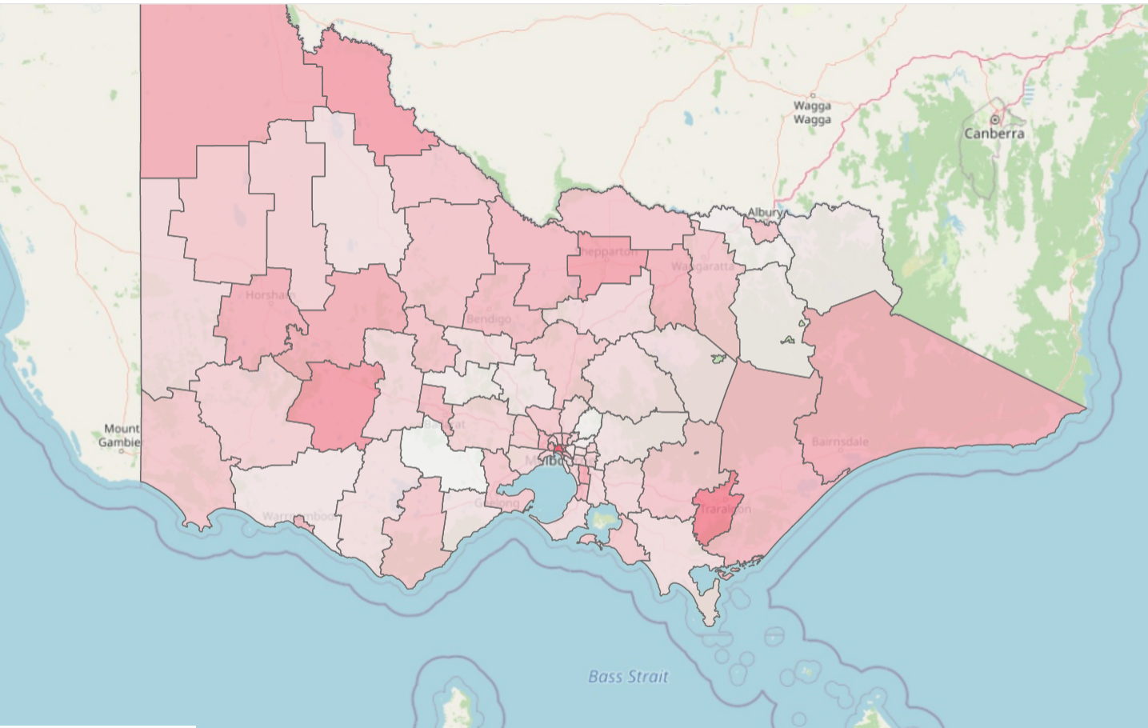
Terminology
What is a Police Service Region?
Local government areas (LGAs) in Victoria, are sorted into five wider POLICE service regions.
LGA’s are also referred to as municipalities, the 79 Victorian LGAs are classified as cities (34), shires (38), rural cities (6) and boroughs (1). In general, an urban or suburban LGA is called a city and is governed by a City Council, while a rural LGA covering a larger rural area is usually called a shire and is governed by a Shire Council.
Local councils have the same administrative functions and similar political structures, regardless of their classification.
In the following slides, the sorting of LGAs into five wider POLICE regions is for presentation purposes and has no legal or administrative significance.

Slide 15
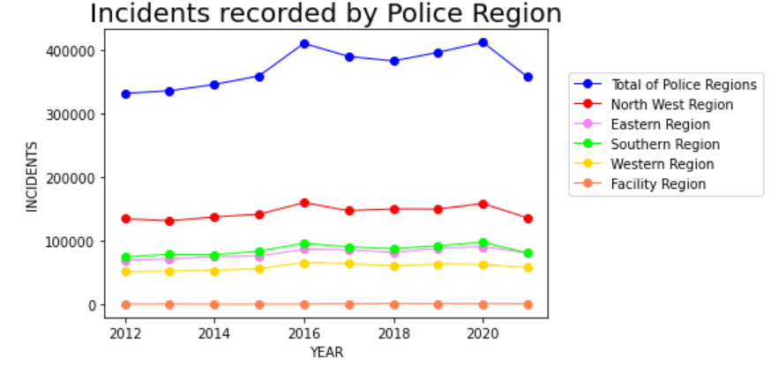
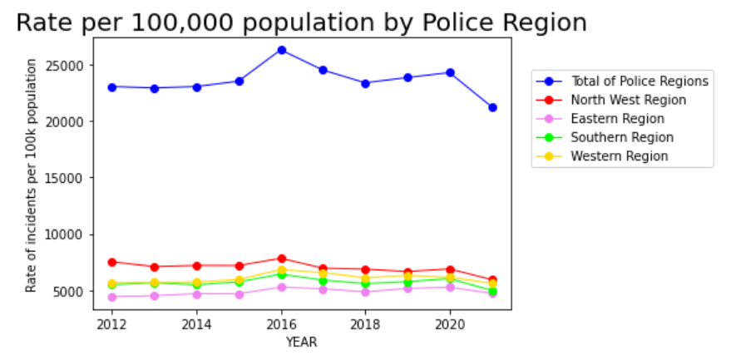
Note:
The Victoria Police Region breakdown shows most crimes are occurring in the North West Region
Rate per 100k population confirms trend.
In the following slide we will investigate the LGA‘s of the North West Region.

Slide 16
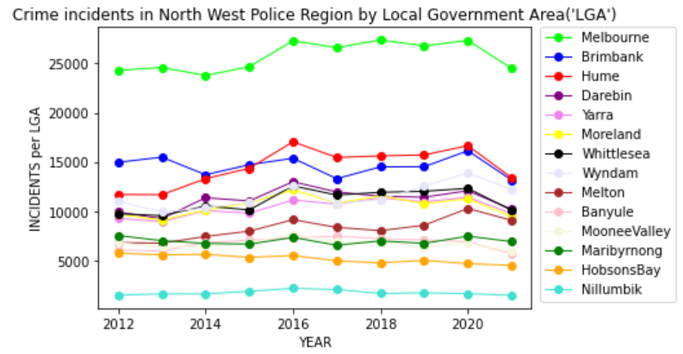
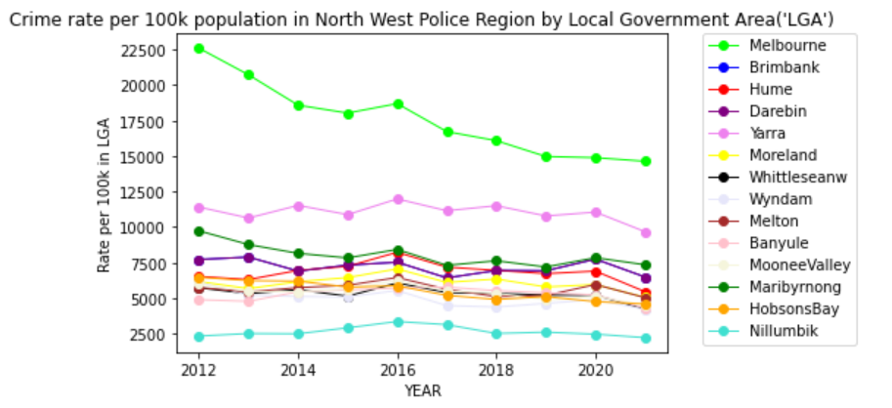
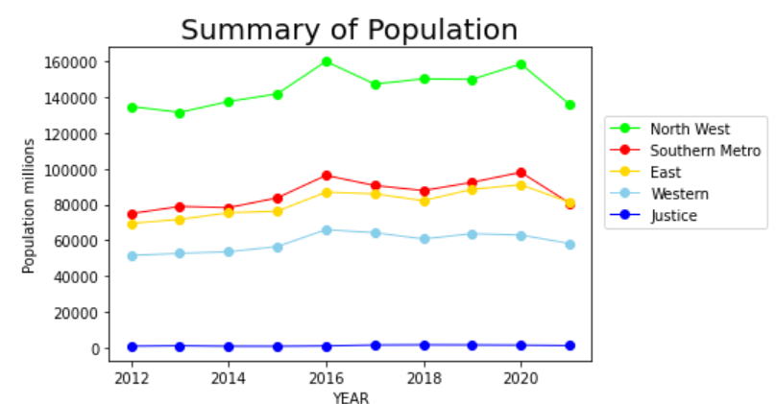
Note:
In North West Police Region, most crimes are occurring in Melbourne LGA (depicted by Green line).
The rate per 100,000 population shows a decrease in crime for Melbourne LGA since 2012.
This decrease is a combination of increased policing and higher population density in the city.
Yarra LGA has a relatively higher crime rate per 100k population.

Slide 17
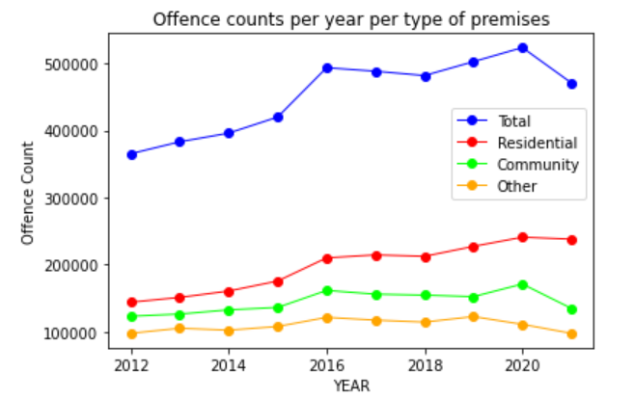
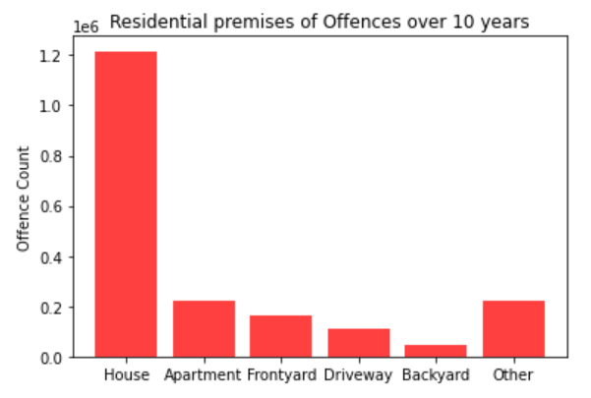
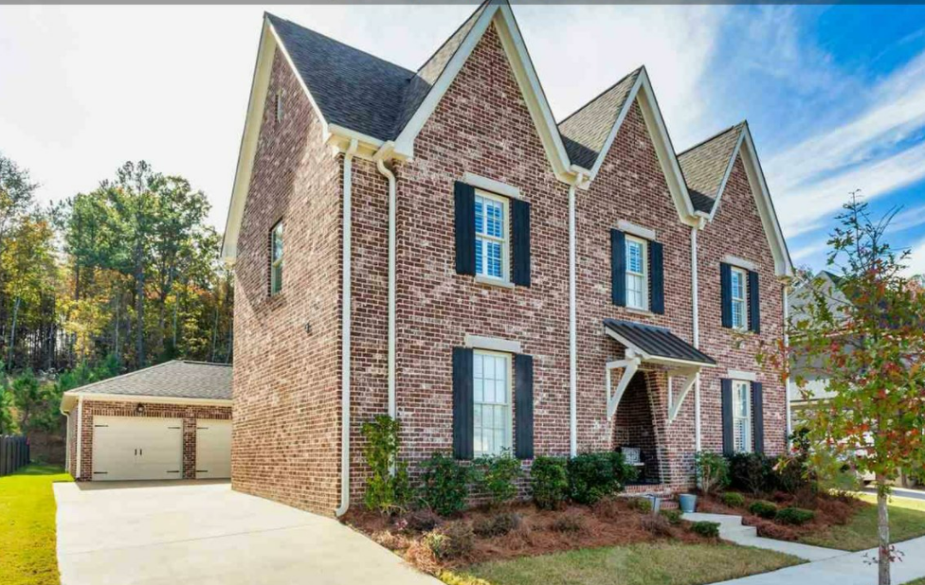
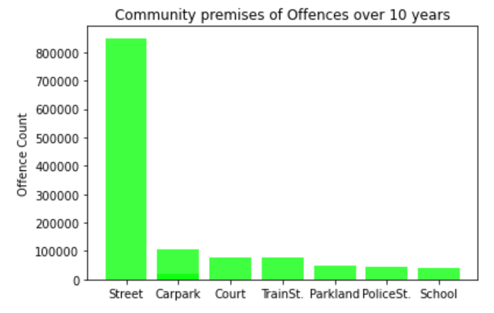

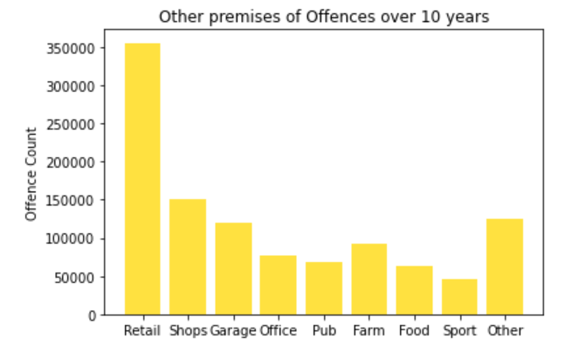
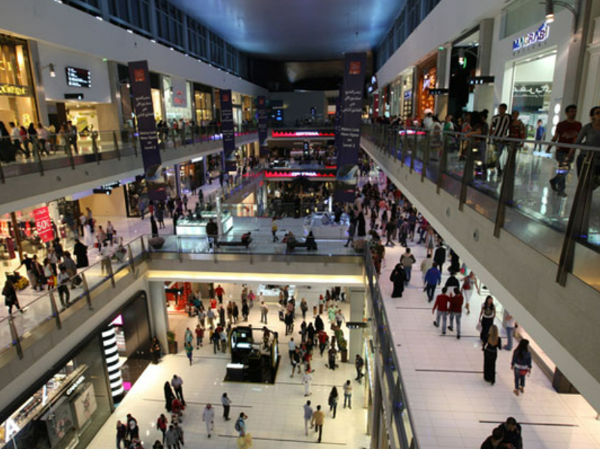
Note:
Most Residential crimes are happening inside Homes.
Streets are where most of the community crimes are occurring.
Crimes in other locations are mostly in the Retail setting

